Slide 1

Environmental Analysis
Co-Sub
Co-Sub
21102052 Lee Jeong-yun | 21102044 Oh Seyeon | 21102050 Lee Insun

Slide 2

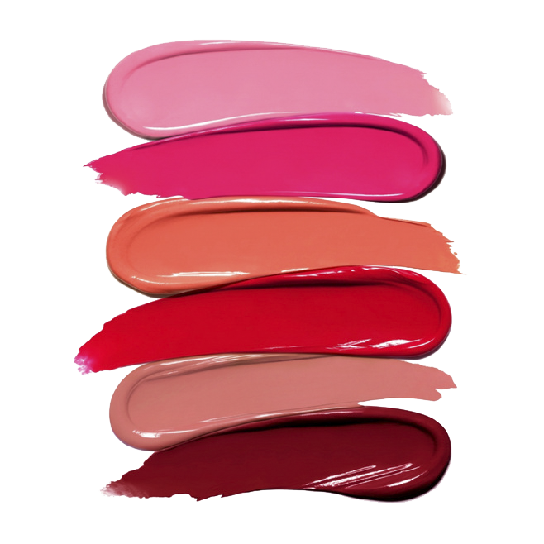
Contents
1.
About Co-Sub
Our Item
a.
b.
Perspective in the Analysis
c.
Adopted Technologies
d.
Current Status and Prospects
2.
a.
Customer Analysis
Market
Analysis
b.
Competitors Analysis
c.
Market Analysis
d.
Regulations

Slide 3
Co-Sub
Our Item : Co-Sub
21102052 Lee Jeong-yun | 21102044 Oh Seyeon | 21102050 Lee Insun

Slide 4

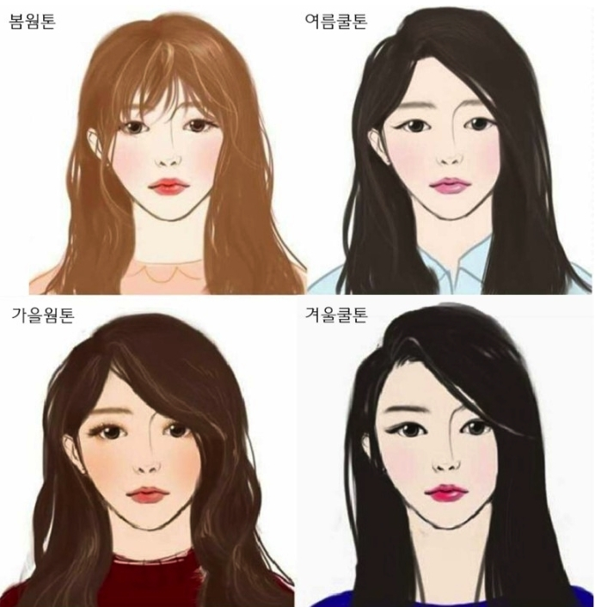
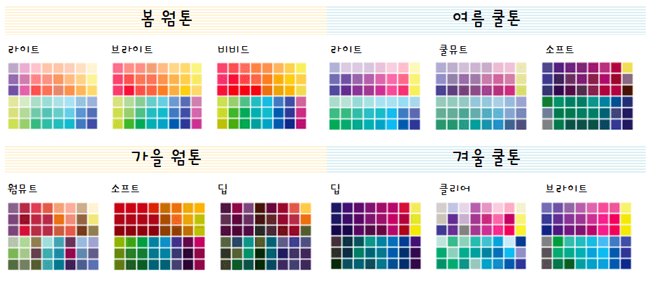
Our Item
1.
About Co-Sub
Motivation
What is personal color?
: Color that best matches the color of the individual's body
Notes:
퍼스널 컬러 정의:
개인이 가진 신체의 색과 어울리는 색. 사용자에게 생기가 돌고 활기차 보이도록 연출하는 이미지 관리 따위에 효과적이다.

Slide 5
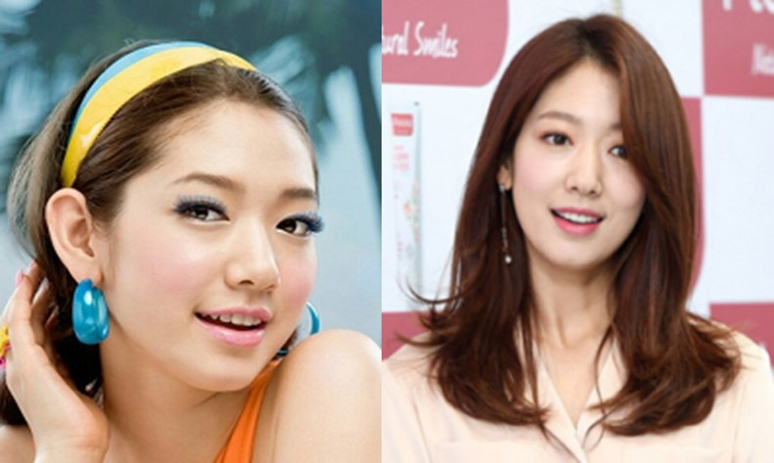
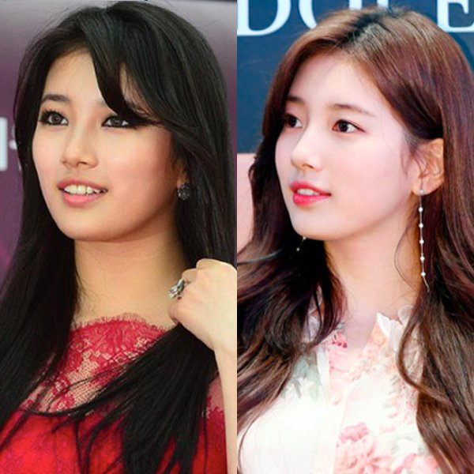
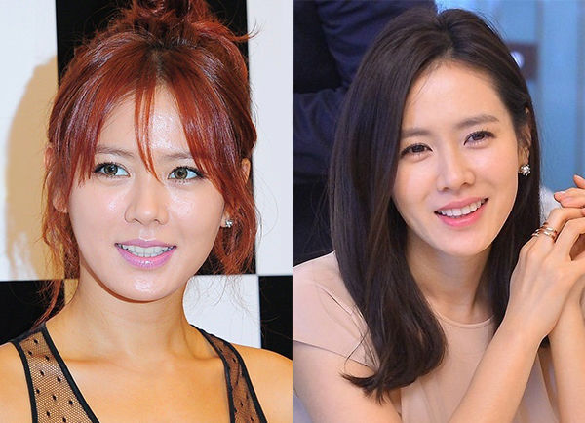
Our Item
1.
About Co-Sub
Motivation
Personal color can help people to makeup very suitable.
Notes:
1. 사진 예시
-> 퍼스널 컬러를 알면 자신에게 어울리는 최적의 Makeup을 할 수 있음
2. 많은 사람들이 자신에게 어울리는 립제품을 찾고자 많은 돈을 사용한다는 것을 알게됨
-> We want to reduce the cost to find best lip color
월정액을 지불해 퍼스널 컬러를 진단받고, 이를 기반한 메이크업 제품 구입을 도와줄 것을 다짐함.
평균 색조 화장품 개수 뷰티누리 - 화장품신문 (Beautynury.com) :: 2040 여성들 색조 화장품 평균 4개 사용…입술 화장 중시

Slide 6
Our Item
1.
About Co-Sub
Motivation
Average Number of Color Cosmetics | 20s | 30s | 40s
 | 5.2 | 3.8 | 3.1
People value the ‘Lip’ as the
Most Important Part of Makeup!
2040 여성들 색조 화장품 평균 4개 사용…입술 화장 중시, Beautynuri, 2019, Https://www.beautynury.com/m/news/view/83430
Notes:
1. 사진 예시
-> 퍼스널 컬러를 알면 자신에게 어울리는 최적의 Makeup을 할 수 있음
2. 많은 사람들이 자신에게 어울리는 립제품을 찾고자 많은 돈을 사용한다는 것을 알게됨
-> We want to reduce the cost to find best lip color
월정액을 지불해 퍼스널 컬러를 진단받고, 이를 기반한 메이크업 제품 구입을 도와줄 것을 다짐함.
평균 색조 화장품 개수 뷰티누리 - 화장품신문 (Beautynury.com) :: 2040 여성들 색조 화장품 평균 4개 사용…입술 화장 중시

Slide 7
Our Item
1.
About Co-Sub
Overview
2
Hunt Personal Color by AI Analysis
Providing various cosmetics until the user finds the preferred colors and the textures
Experience recommended products based on the result
Cosmetic Subscription Service
1
3
Notes:
ai기술로 퍼스널컬러를 진단받고 이를 바탕으로 추천받은 립 제품들을 체험해볼 수 있는 화장품 구독 서비스입니다.
사용자가 구독하면 자신에게 어울리는 립 제품의 색상과 텍스쳐를 발견할 때까지 일정 기간 동안 다양한 색상의 틴트를 제공합니다.

Slide 8


Our Item
1.
About Co-Sub
Target Group
People who haven’t
Found the Proper Lip Color and Texture for them.
Notes:
타겟층 :
자신에게 맞는 립 색상과 텍스쳐를 발견하지 못한 사람들
화장품 관련 소식을 알고 싶은 사람들
피부 건강을 위해 화장품 유통기한에 관심이 있는 사람들

Slide 9







Our Item
1.
About Co-Sub
What Services?
1) Cosmetic Subscription Service Based on AI
Uploading Selfie Without Makeup
Analysis of Personal Color
and Lip Color Based on AI
Select the Product from
the List of Recommended Products
Delivery and Experience the Products
Notes:
AI기반 화장품 구독서비스
- 해당 서비스에 화장을 하지 않은 자신의 얼굴 사진을 업로드 합니다. 그러면 퍼스널 컬러 분석 결과를 데이터로 가지고 있는 AI가 사용자에게 어울리는 립 색상을 분석합니다. 그 다음 맞춤형 립 제품들로 이루어진 리스트를 보여주고, 리스트 중 고객이 사용하고 싶은 제품을 2개 선택합니다. 그러면 저희의 서비스가 해당 제품을 배송해줍니다. 그러면 고객은 립 제품들을 체험 후 리뷰를 작성합니다.
퍼스널 컬러 기반 화장품 진단 서비스
- 빅데이터를 사용해 화장품들을 퍼스널 컬러에 맞춰 분류합니다. 그리고 사용자가 진단 받고 싶은 화장품의 이름과 호수를 검색하면, 해당 화장품이 사용자의 퍼스널컬러에 적합한지 판단해줍니다.
화장품 사용기한 알림 서비스
- 화장품들은 모두 유통기한을 가지고 있습니다. 제품을 구입시 사용자가 마이페이지에 들어가 구입한 화장품의 개봉날짜를 적으면 화장품 유통기한의 만료일 전에 사용자에게 알림을 울려줍니다.
커뮤니티 플랫폼
화장품에 관련된 다양한 콘텐츠들이 펼쳐집니다. 화장품 리뷰, 화장품을 가지고 만드는 쇼츠 영상, 화장품 게임, 화장품 웹툰 등 화장품에 관심있는 사람들이 화장품을 주제로 소통할 수 있는 커뮤니티 플랫폼입니다.

Slide 10
Our Item
1.
Perspective of Analysis
Virtual Company,
‘ ’
Co-Sub
Co-Sub | Make an Economic Profit by subscription fee from user
Our Partners | Can Promote their products
Users | Can find Fit Cosmetic Products Get Information about cosmetics from the Community
Notes:
Perspective in the analysis: Virtual company ‘Co-Sub’
- Necessity of business (표)
Co-Sub : Make an economic profit by subscription fee from user
Cooperative cosmetic companies: Be able to promote their product
User: Be able to find fit cosmetic products, Get information about cosmetics in community plattform

Slide 11


Our Item
1.
Adopted Technologies
AI Analysis
Big-data Analysis
Notes:
AI analysis: 퍼스널컬러를 진단할 때 사용
Bigdata analysis: 화장품이 사용자의 퍼스널컬러에 적합한지 판단할 때 사용
사용자의 수요를 파악해 개인의 노력을 감소시키고 그만큼 부가가치를 창출하는 것이 컬러버랩의 핵심 목표

Slide 12
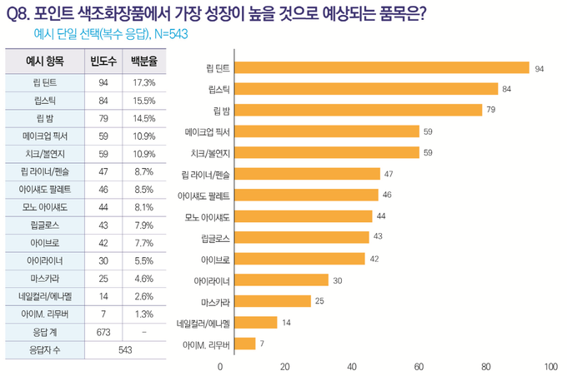
Our Item
1.
Current Status
Lip Products Have
High Growth Potential
[2022 신년특집] 2022년 화장품업계 트렌드와 이슈는? (cosinkorea.com)
Notes:
색조 화장품 중에서 립 제품이 가장 성장가능성이 높다.

Slide 13
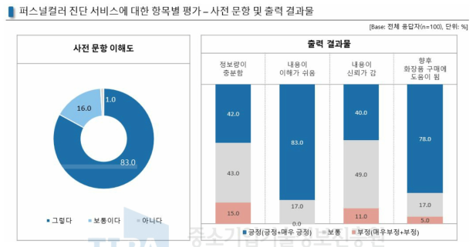
Our Item
1.
Prospects
[보고서]AR기반의 스마트미러 장치를 활용한 퍼스널 컬러 진단 및 제품 추천 서비스 (kisti.re.kr)
Personal Color Helps People Select Cosmetics
Notes:
퍼스널컬러 진단은 사람들이 화장품을 선택하는 것에 도움이 됨

Slide 14
Our Item
1.
Prospects
Average Cost = 92258.5 Won
Expensive Test from the Human Experts

Slide 15
Our Item
1.
Prospects
Result :
Selecting Lip Products with the Highest
Growth Potential
‘ ’
Co-Sub
Reducing the cost of hunting personal colors
Notes:
결론: ‘cosub’은 색조 화장품 중에서 성장 가능성이 가장 높은 립 제품을 주요 상품으로 선정
또한 화장품 선택에 도움이 되는 퍼스널컬러 진단 비용을 절감할 수 있어 미래가 밝다

Slide 16
Co-Sub
Market
21102052 Lee Jeong-yun | 21102044 Oh Seyeon | 21102050 Lee Insun

Slide 17
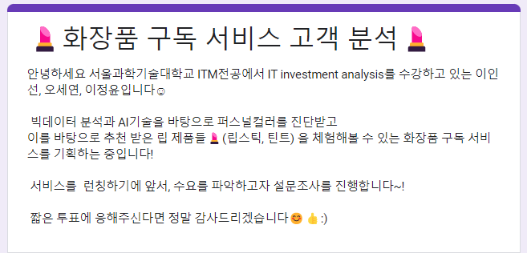
Market
2.
Consumer Analysis
Purpose
1) To find out the number of people who experience personal color experience.
2) To find out the number of people who experienced a fail to buy color cosmetics online .
3) To find out our service demand.
Notes:
목적
1) To find out the number of people who experience personal color experience
2) To find out the number of people who experienced a fail to buy color cosmetics online shopping.
3) To find out our service demand
1) 퍼스널컬러 진단 경험
2) 잭조 화장품을 온라인으로 구매했을때 실패했던 경험 여부 파악
3) 수요예측

Slide 18
Market
2.
Consumer Analysis
Result
Notes:
결론
1) 퍼스널컬러 진단 경험 →
2) 잭조 화장품을 온라인으로 구매했을때 실패했던 경험 여부 파악 →온라인 후기만으로는 자신에게 어울리는 립 제품을 찾기에 한계가 있음
3) 수요예측 →

Slide 19
Market
2.
Consumer Analysis
Result
Notes:
결론
1) 퍼스널컬러 진단 경험 →
2) 잭조 화장품을 온라인으로 구매했을때 실패했던 경험 여부 파악 →온라인 후기만으로는 자신에게 어울리는 립 제품을 찾기에 한계가 있음
3) 수요예측 →

Slide 20
Market
2.
Consumer Analysis
Result
‘ ’
Co-Sub
Notes:
결론
1) 퍼스널컬러 진단 경험 →
2) 잭조 화장품을 온라인으로 구매했을때 실패했던 경험 여부 파악 →온라인 후기만으로는 자신에게 어울리는 립 제품을 찾기에 한계가 있음
3) 수요예측 →

Slide 21
Market
2.
Competitors Analysis
 | OLIVE YOUNG | Hwahae | Zamface | Co-Sub
# Users | 100M | 100M | 10M | Unpredictable
Cost | 13,310 Won (Average of TOP 10 Lip) | 9,940 Won (Average of Top 10 Lip) | 10,105 Won (Average of Top 10 Lip) | Under 9,940 Won per Quarter
How to Experience | Offline Shop | X | X | Regular Delivery
Personal Color | X | X | O | O
Notes:
평균 가격: 11,181
3개월에 서비스 2번 이용 -> 제품 1개씩 배송

Slide 22
Market
2.
Cost
Competitiveness
Market Analysis
Positioning Map
Cosub
HWAHAE
Zam face
Personal Color
Olive
young

Slide 23
Market
2.
Market Analysis
Five Force’s Model
Competitive
Rivalry
Threats of new entry
Buyer power
Threats of substitutes
Supplier power
Notes:
Substitute
- The method of offline lip color testing requires effort
No service to completely replace the experience subscription service of 'COSUB’.
Supplier power
All cosmetics companies that sell lip products are suppliers -> Many alternative suppliers
Supplier's sales can increase due to product promotion effect by using 'COSUB' -> Supplier engagement is high
Excluding inflation, the price of cosmetics sold is constant -> Low possibility of change in unit price of supply products
Competitive Rivalry
Big difference in the way of experience from existing cosmetics companies -> Low competition
Threats of new entry
- Agreements with various cosmetics brands, data on personal color analysis, and AI development costs are required → High entry barriers
- Not only purchasing cosmetics but also accessing various contents related to cosmetics through the community service --> High brand loyalty
Buyer power
- According to statistics that an average of four lip products are used per person, two products are used for one subscription to COSUB, and two subscriptions are expected per person
- Unable to replace 'COSUB' from the buyer's point of view
- Experiencing a variety of colors at the same price -> Having a value to pay price from the buyer's point of view

Slide 24
Market
2.
Market Analysis
Five Force’s Model
Competitive
Rivalry
Threats of new entry
Buyer power
Threats of substitutes
Supplier power
Competitive Rivalry
Big difference in the way of experience from existing cosmetics companies
→ Low competition
Notes:
Substitute
- The method of offline lip color testing requires effort
No service to completely replace the experience subscription service of 'COSUB’.
Supplier power
All cosmetics companies that sell lip products are suppliers -> Many alternative suppliers
Supplier's sales can increase due to product promotion effect by using 'COSUB' -> Supplier engagement is high
Excluding inflation, the price of cosmetics sold is constant -> Low possibility of change in unit price of supply products
Competitive Rivalry
Big difference in the way of experience from existing cosmetics companies -> Low competition
Threats of new entry
- Agreements with various cosmetics brands, data on personal color analysis, and AI development costs are required → High entry barriers
- Not only purchasing cosmetics but also accessing various contents related to cosmetics through the community service --> High brand loyalty
Buyer power
- According to statistics that an average of four lip products are used per person, two products are used for one subscription to COSUB, and two subscriptions are expected per person
- Unable to replace 'COSUB' from the buyer's point of view
- Experiencing a variety of colors at the same price -> Having a value to pay price from the buyer's point of view

Slide 25
Market
2.
Market Analysis
Five Force’s Model
Competitive
Rivalry
Threats of new entry
Buyer power
Threats of substitutes
Supplier power
Threats of new entry
- Agreements with various cosmetics brands, data on personal color analysis, and AI development costs are required → High entry barriers
- Not only purchasing cosmetics but also accessing various contents related to cosmetics through the community service → High brand loyalty
Notes:
Substitute
- The method of offline lip color testing requires effort
No service to completely replace the experience subscription service of 'COSUB’.
Supplier power
All cosmetics companies that sell lip products are suppliers -> Many alternative suppliers
Supplier's sales can increase due to product promotion effect by using 'COSUB' -> Supplier engagement is high
Excluding inflation, the price of cosmetics sold is constant -> Low possibility of change in unit price of supply products
Competitive Rivalry
Big difference in the way of experience from existing cosmetics companies -> Low competition
Threats of new entry
- Agreements with various cosmetics brands, data on personal color analysis, and AI development costs are required → High entry barriers
- Not only purchasing cosmetics but also accessing various contents related to cosmetics through the community service --> High brand loyalty
Buyer power
- According to statistics that an average of four lip products are used per person, two products are used for one subscription to COSUB, and two subscriptions are expected per person
- Unable to replace 'COSUB' from the buyer's point of view
- Experiencing a variety of colors at the same price -> Having a value to pay price from the buyer's point of view

Slide 26
Market
2.
Market Analysis
Five Force’s Model
Competitive
Rivalry
Threats of new entry
Buyer power
Threats of substitutes
Supplier power
Supplier power
All cosmetics companies that sell lip products are suppliers → Many alternative suppliers
Supplier's sales can increase due to product promotion effect by using 'COSUB' -> Supplier engagement is high
Excluding inflation, the price of cosmetics sold is constant
→ Low possibility of change in unit price of supply products
Notes:
Substitute
- The method of offline lip color testing requires effort
No service to completely replace the experience subscription service of 'COSUB’.
Supplier power
All cosmetics companies that sell lip products are suppliers -> Many alternative suppliers
Supplier's sales can increase due to product promotion effect by using 'COSUB' -> Supplier engagement is high
Excluding inflation, the price of cosmetics sold is constant -> Low possibility of change in unit price of supply products
Competitive Rivalry
Big difference in the way of experience from existing cosmetics companies -> Low competition
Threats of new entry
- Agreements with various cosmetics brands, data on personal color analysis, and AI development costs are required → High entry barriers
- Not only purchasing cosmetics but also accessing various contents related to cosmetics through the community service --> High brand loyalty
Buyer power
- According to statistics that an average of four lip products are used per person, two products are used for one subscription to COSUB, and two subscriptions are expected per person
- Unable to replace 'COSUB' from the buyer's point of view
- Experiencing a variety of colors at the same price -> Having a value to pay price from the buyer's point of view

Slide 27
Market
2.
Market Analysis
Five Force’s Model
Competitive
Rivalry
Threats of new entry
Buyer power
Threats of substitutes
Supplier power
Threat of substitute
- The method of offline lip color testing requires effort
- No service to completely replace the experience subscription service of 'COSUB’.
Notes:
Substitute
- The method of offline lip color testing requires effort
No service to completely replace the experience subscription service of 'COSUB’.
Supplier power
All cosmetics companies that sell lip products are suppliers -> Many alternative suppliers
Supplier's sales can increase due to product promotion effect by using 'COSUB' -> Supplier engagement is high
Excluding inflation, the price of cosmetics sold is constant -> Low possibility of change in unit price of supply products
Competitive Rivalry
Big difference in the way of experience from existing cosmetics companies -> Low competition
Threats of new entry
- Agreements with various cosmetics brands, data on personal color analysis, and AI development costs are required → High entry barriers
- Not only purchasing cosmetics but also accessing various contents related to cosmetics through the community service --> High brand loyalty
Buyer power
- According to statistics that an average of four lip products are used per person, two products are used for one subscription to COSUB, and two subscriptions are expected per person
- Unable to replace 'COSUB' from the buyer's point of view
- Experiencing a variety of colors at the same price -> Having a value to pay price from the buyer's point of view

Slide 28
Market
2.
Market Analysis
Five Force’s Model
Competitive
Rivalry
Threats of new entry
Buyer power
Threats of substitutes
Supplier power
Buyer power
- According to statistics that an average of four lip products are used per person, two products are used for one subscription to COSUB, and two subscriptions are expected per person
- Unable to replace 'COSUB' from the buyer's point of view
- Experiencing a variety of colors at the same price
→ Having a value to pay price from the buyer's point of view
Notes:
Substitute
- The method of offline lip color testing requires effort
No service to completely replace the experience subscription service of 'COSUB’.
Supplier power
All cosmetics companies that sell lip products are suppliers -> Many alternative suppliers
Supplier's sales can increase due to product promotion effect by using 'COSUB' -> Supplier engagement is high
Excluding inflation, the price of cosmetics sold is constant -> Low possibility of change in unit price of supply products
Competitive Rivalry
Big difference in the way of experience from existing cosmetics companies -> Low competition
Threats of new entry
- Agreements with various cosmetics brands, data on personal color analysis, and AI development costs are required → High entry barriers
- Not only purchasing cosmetics but also accessing various contents related to cosmetics through the community service --> High brand loyalty
Buyer power
- According to statistics that an average of four lip products are used per person, two products are used for one subscription to COSUB, and two subscriptions are expected per person
- Unable to replace 'COSUB' from the buyer's point of view
- Experiencing a variety of colors at the same price -> Having a value to pay price from the buyer's point of view

Slide 29
Market
2.
Market Analysis - SWOT
Strength
Weakness
Having Price Superiority
Lower Awareness than the Competitors
Lower Cost of Checking Personal Color
New Demands Except for Lip Products
Personal Data Based Recommendation
Secure Various Brands and Products
Opportunity
Threat
Steep Development of the Cosmetic Industry
Similar Service from Cosmetic Makers
Vogue for Individualized Makeup
Continuous Increase in Distribution Cost
Popularized Subscription Services
Pressure by Existing Retail Business

Slide 30

Market
2.
Regulations
Cosmetic Regulatory Framework in Korea. (2020). MFDS.
Ministry of Food and
Drug Safety
Cosmetics Act
Enforcement Rule of
Cosmetics Act
MFDS Notification
Enforcement Decree of
Cosmetics Act
Cosmetics Responsible Person Registration
Compliance with Labeling Rules
Ensuring Post-marketing Safety Management
Substantiation of Advertisement

Slide 31
Environmental Analysis
Thanks
Thanks
21102052 Lee Jeong-yun | 21102044 Oh Seyeon | 21102050 Lee Insun

